Slide 1
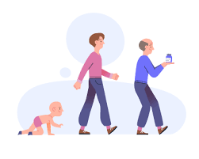
Face and Age Detection

Slide 2
Problem Definition
Age one of the key facial attributes, play a very foundational role in social interactions. Making age estimation from a single face image an important task in intelligent applications, such as access control, human-computer interaction, law enforcement, marketing intelligence and visual surveillance, etc.

Slide 3
Objective
Our objective is to develop a python project which involves deep learning particularly CNN(convolutional neural network) technology to predict the approximate age group to which the person belongs to through his/her facial image.
We will use the models trained by Tal Hassner and Gil Levi.

Slide 4
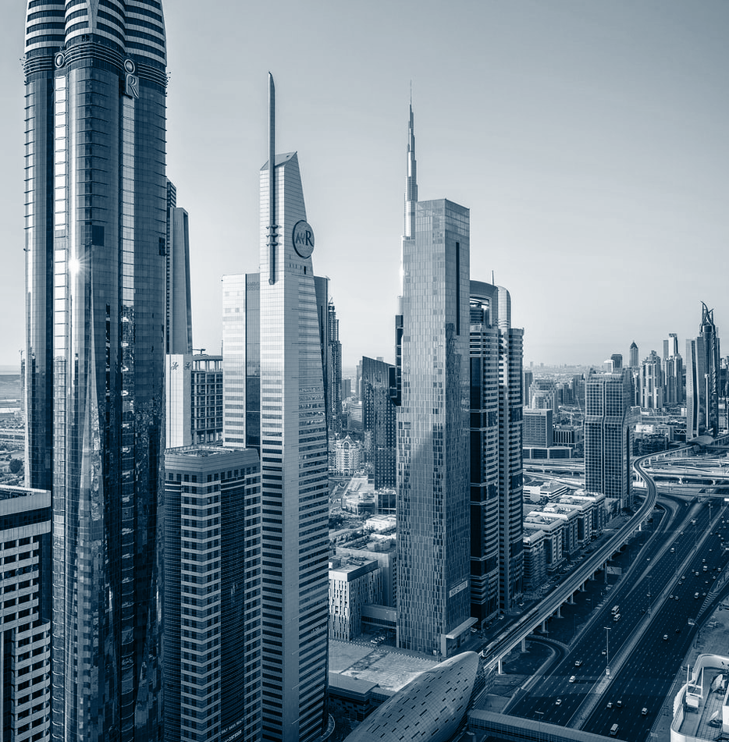
Design and Methodology

Slide 5
Block Diagram
Static
Image
Face Detection
Feature Extraction
Convolutional Neural Network
Face and Age Detection
Trained Dataset

Slide 6
Methodology
The age detection is implemented in two stages:
Stage 1: Detect faces in the input Static Image
Stage 2: Extract the face Region of Interest (ROI), and apply the age detector algorithm to predict the age of the person

Slide 7
Methodology
The face detector (Stage 1) produces the bounding box coordinates of the face in the image.
Once the bounding box (x, y)-coordinates of the face is obtained, we first extract the face ROI, ignoring the rest of the image/frame.

Slide 8
Methodology
The face ROI is then passed through the model, yielding the actual age prediction.
The deep learning age detector model we are using here today was implemented and trained by Levi and Hassner in their 2015 publication, Age and Gender Classification Using Convolutional Neural Networks.

Slide 9

Why aren’t we treating age prediction as a regression problem?

Slide 10
Reason
Once you start treating age prediction as a regression problem, it becomes significantly harder for a model to accurately predict a single value representing that person’s image.
However, if you treat it as a classification problem, defining buckets/age brackets for the model, our age predictor model becomes easier to train, often yielding substantially higher accuracy than regression-based prediction alone.

Slide 11
AlexNet-like Architecture
In the paper, the authors propose a simplistic AlexNet-like architecture that learns a total of eight age brackets:
0-2 | 25-32
4-6 | 38-43
8-12 | 48-53
15-20 | 60+

Slide 12

Implementation Details

Slide 13
Tech stack
OpenCV:
It is a cross-platform library using which we can develop real-time computer vision applications. It mainly focuses on image processing, video capture and analysis including features like face detection and object detection.
Python:
Python is a general-purpose interpreted, interactive, object-oriented, and high-level programming language.
NumPy:
NumPy is a library for the Python programming language, adding support for large, multi-dimensional arrays and matrices, along with a large collection of high-level mathematical functions to operate on these arrays.

Slide 14
Tech stack
Imutils
Imutils are a series of convenience functions to make basic image processing functions such as translation, rotation, resizing, skeletonization, and displaying Matplotlib images easier with OpenCV and Python 3.
Time
Time module provides many ways of representing time in code, such as objects, numbers, and strings. It also provides functionality other than representing time, like waiting during code execution.

Slide 15
Tech stack
Argparse
The argparse module makes it easy to write user-friendly command-line interfaces. It also automatically generates help and usage messages and issues errors when users give the program invalid arguments.
OS
OS comes under Python’s standard utility modules.This module provides a portable way of using operating system dependent functionality.

Slide 16
Module-wise Implementation 1. Age Detection using Static Image
The two directories consist of our age predictor and face detector. Each of these deep learning models is Caffe-based.

Slide 17
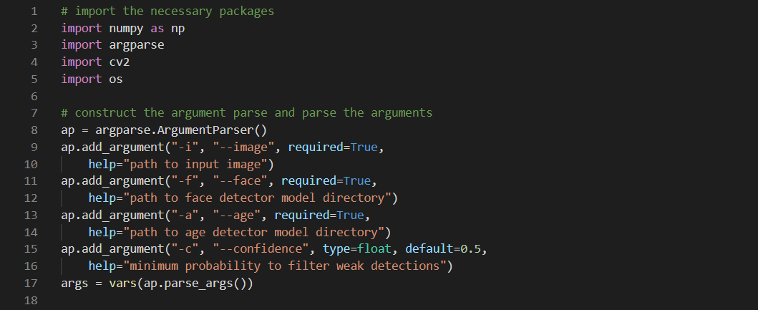
Command Line arguments
--image: Provides the path to the input image of age detection
--face: The path to our pre-trained face detector model directory.
--age: Our pre-trained age detector model directory.
--confidence: The minimum probability threshold in order to filter weak detections.

Slide 18
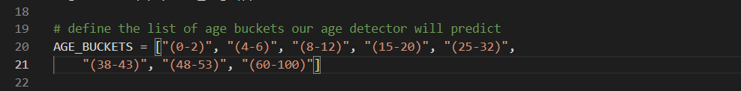
Defining the list of age buckets
Our ages are defined in buckets (i.e., class labels) for our pre-trained age detector. We’ll use this list and an associated index to grab the age bucket to annotate on the output image.

Slide 19
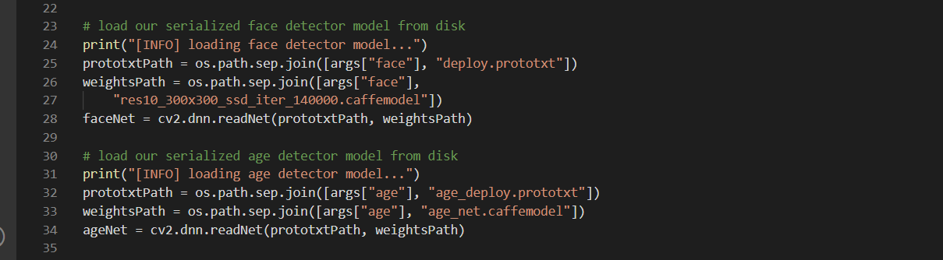
Loading our two pre-trained models
Our face detector finds and localizes faces in the image (Lines 25-28)
The age classifier determines which age range a particular face belongs to (Lines 32-34)
Each of these models was trained with the Caffe framework.

Slide 20
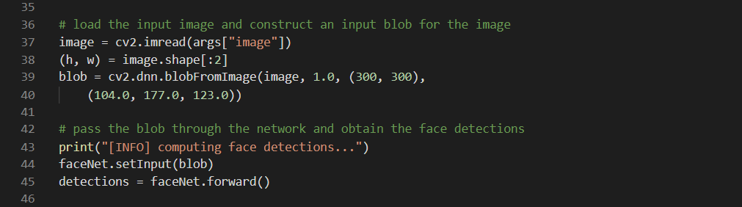
Loading and preprocessing an image from Disk
For loading and preprocessing our input –image . We use OpenCV’s blobFromImage method.(Lines 37-40)
To detect faces in our image ,we send the blob through our CNN, resulting in a list of detections.

Slide 21
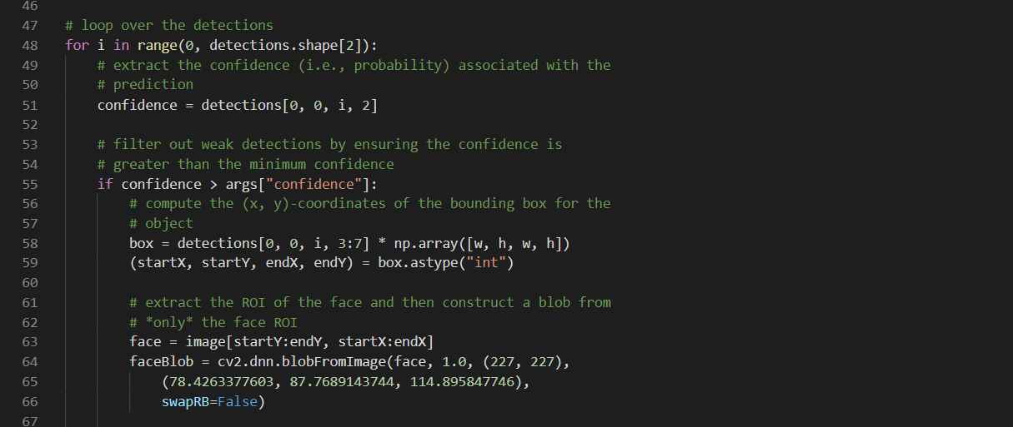
Looping over face ROI detections
As we loop over the detections, we filter out weak confidence faces(Lines-51-55).
For faces that meet the minimum confidence criteria we extract the ROI coordinates(Lines 58-63). At this point, we have a small crop from the image containing only a face. We then create a blob from this ROI(Lines 64-66)

Slide 22
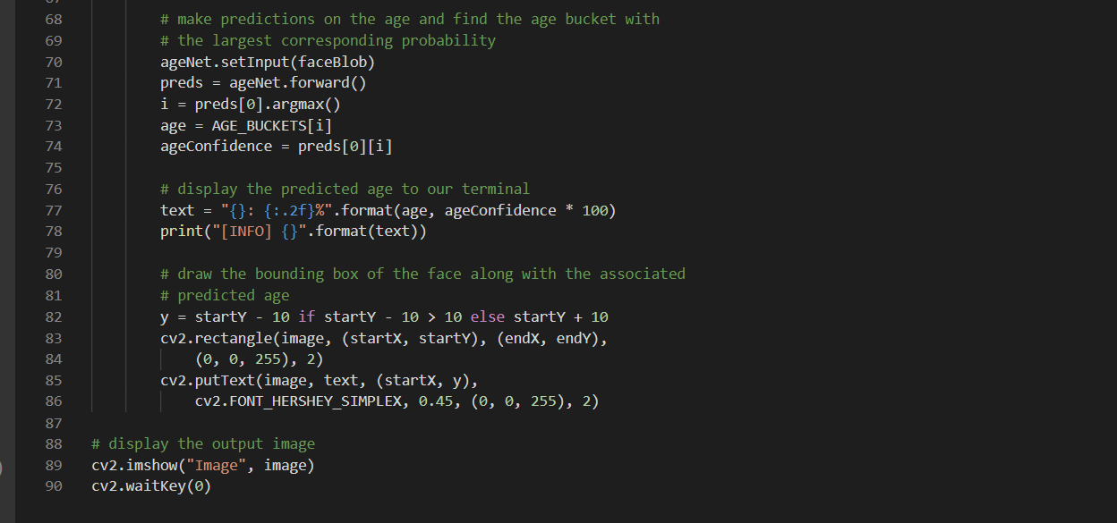
Performing age detection
Using our face blob, we make age predictions (Lines 70-74) resulting in an age bucket and age confidence. We use these data points along with the coordinates of the face ROI to annotate the original input –image(Lines 77-86) and display results(Lines 89 and 90).

Slide 23
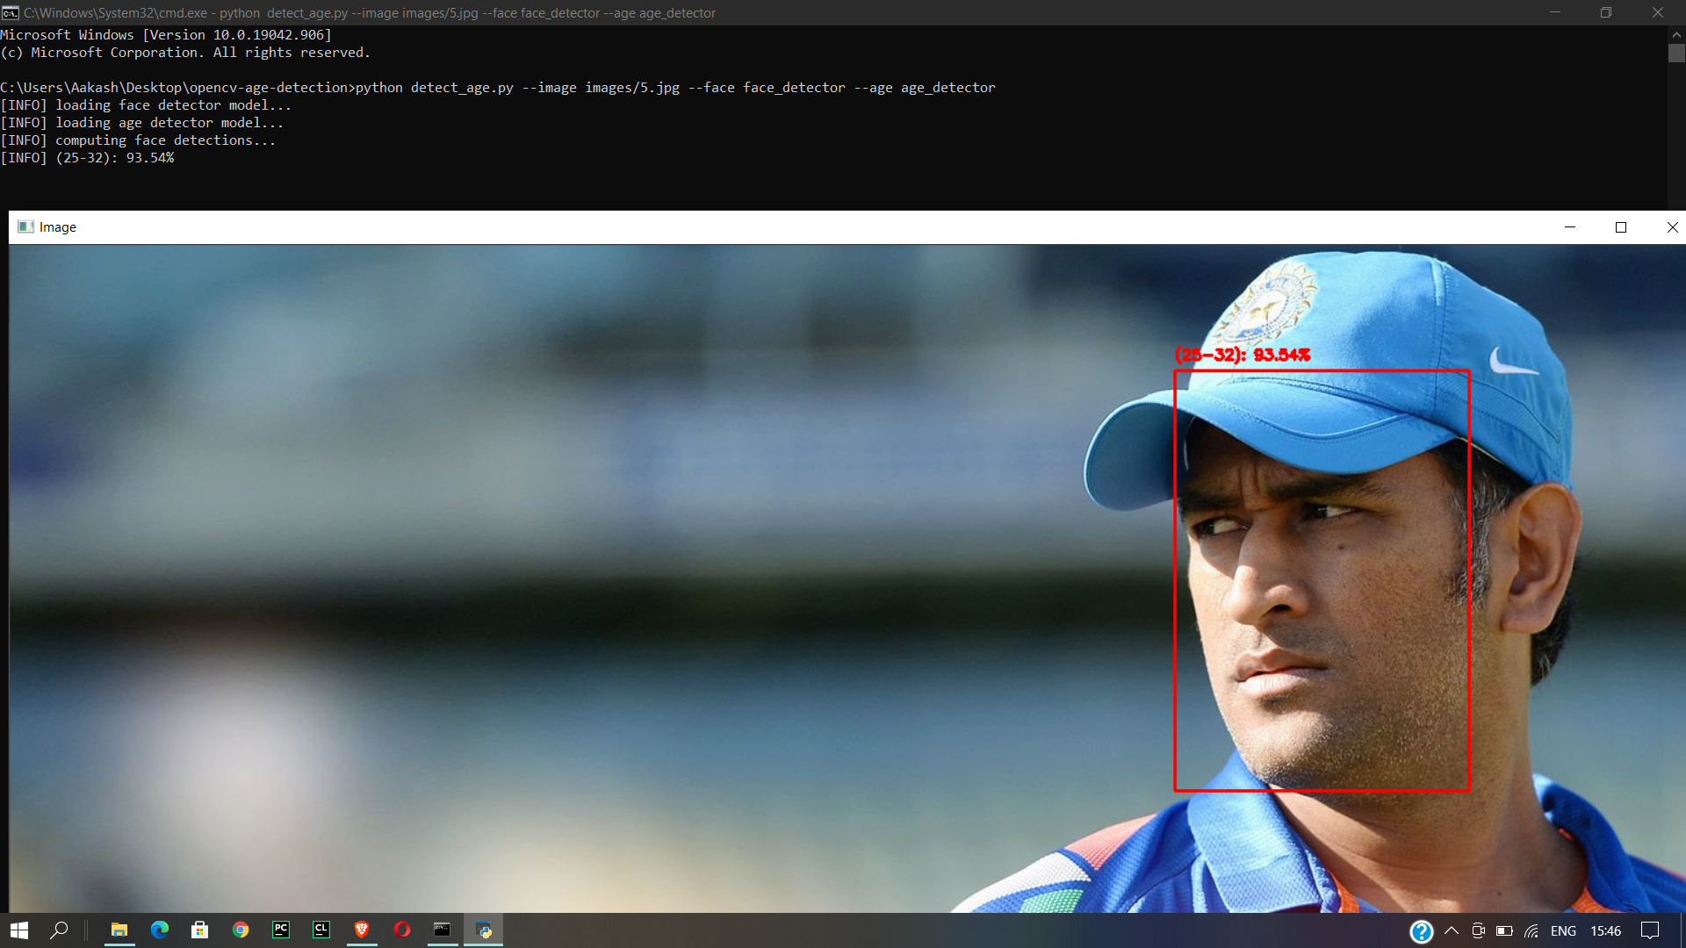
Results
Our project was succesfully able to predict the approximate age of MS Dhoni who was 30 years when the photo was shot.

Slide 24
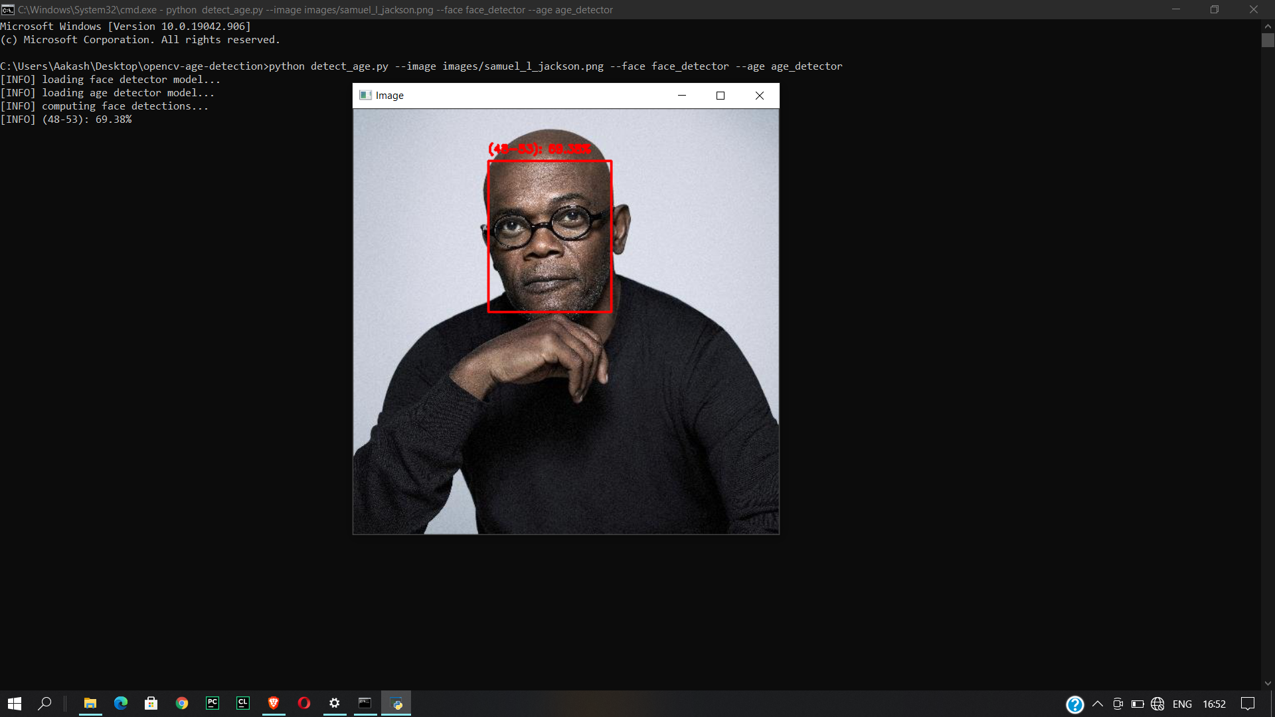
Results
Our project however failed in case of detecting age for Samuel Jackson who is actually 71 years old in the picture. Infact humans would also perceive him of being around 50-60 yrs old.

Slide 25
Module-wise Implementation 2. Age Detection using Web Cam
It is Real-time video streams.
The difference is that we need to set up a video stream and perform age detection on each and every frame in a loop.

Slide 26
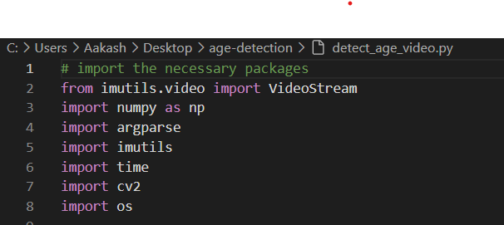
Libraries used
We have three new imports
VideoStream
Imutils
time
These imports allow us to setup and use our webcam for our video stream.

Slide 27
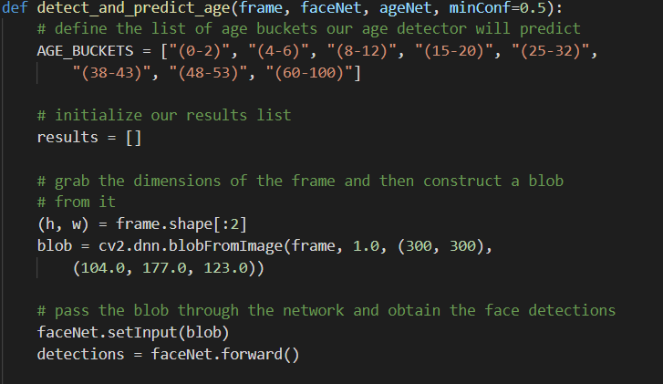
Detect and Predict age function
Our Funtion accept following as parameters
Frame:
FaceNet:
AgeNet
minConf:
These parameters
draw parallels from
command line arguments
of our single age
detector script.

Slide 28
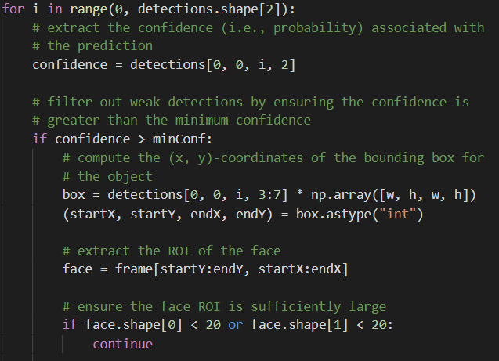
Looping over face ROI detections Looping over face ROI detections
Similar Looping for
Detection as Done for Static
Image.

Slide 29
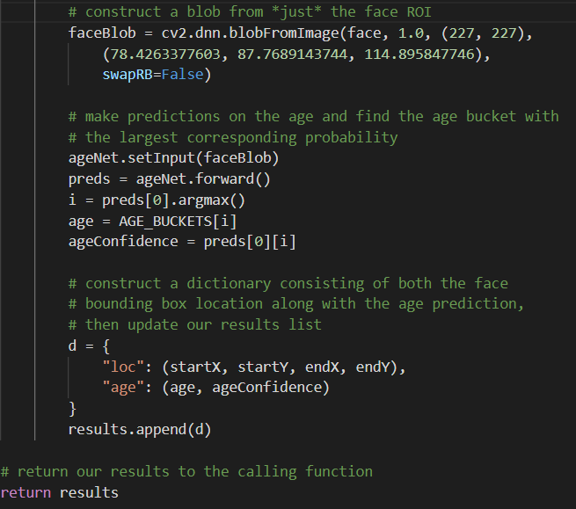
Performing age detection
Similarly done as Image
Age prediction

Slide 30
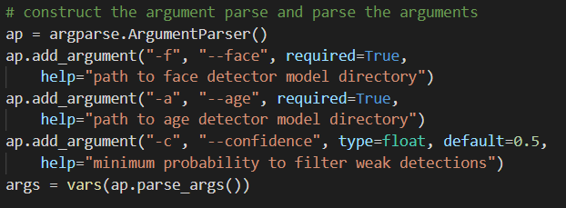
Command Line Arguments
Our Script requires three command line arguments:
--face:
--age:
--confidence:

Slide 31
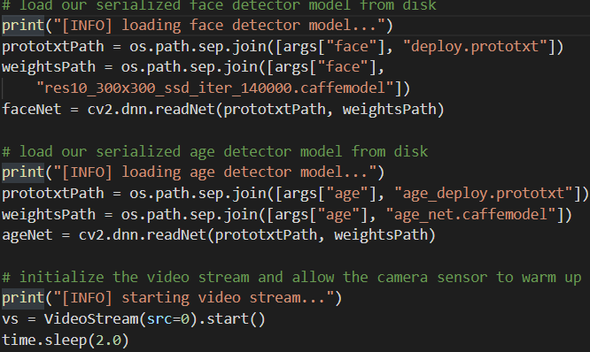
Initialize our video stream
Initialize our face detector
Load our face detector
Use VideoStream class to initianlize our webcam

Slide 32
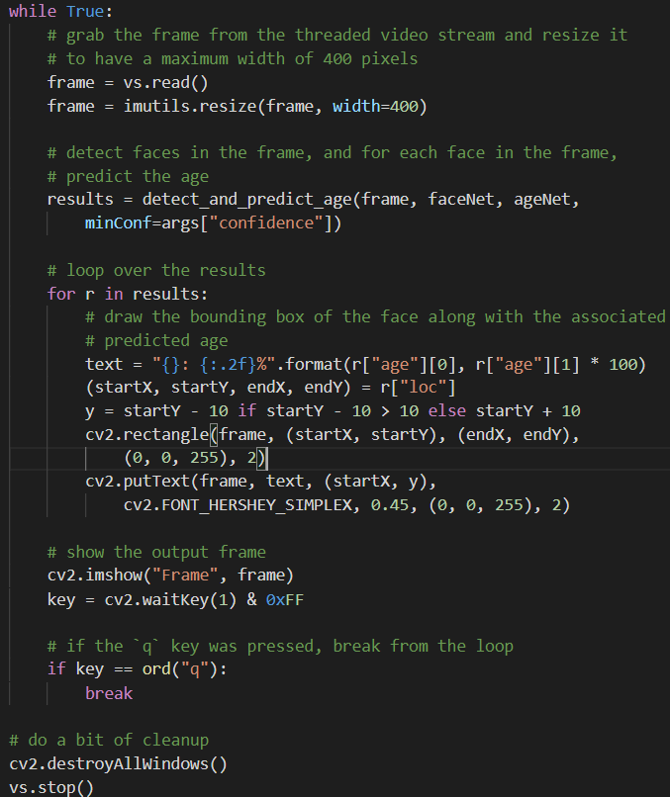
Inside Loop
The While Loop for all mechanism of
Age Detection in Video Stream.

Slide 33
Conclusion
The process of visual age prediction is difficult, and we’d consider it subjective when either a computer or a person tries to guess someone’s age. In order to evaluate an age detector, you cannot rely on the person’s actual age. Instead, you need to measure the accuracy between the predicted age and the perceived age.

Slide 34
Reference
G. Levi and T. Hassner, “Age and gender classification using convolutional neural networks,” in Proceedings of the 2015 IEEE Conference on Computer Vision and Pattern Recognition Workshops (CVPRW), pp. 34–42, Boston, MA, USA, June 2015.View at: Google Scholar
https://opencv.org/
https://talhassner.github.io/home/projects/Adience/Adience-data.html#agegender
https://opencv-python-tutroals.readthedocs.io/en/latest/py_tutorials/py_setup/py_setup_in_windows/py_setup_in_windows.html
https://towardsdatascience.com/a-simple-guide-to-command-line-arguments-with-argparse-6824c30ab1c3?gi=854db45267a0#:~:text=The%20standard%20Python%20library%20argparse,to%20be%20parsed%20and%20utilized.

Slide 35
Thanks!
Any questions?

